Slide 1
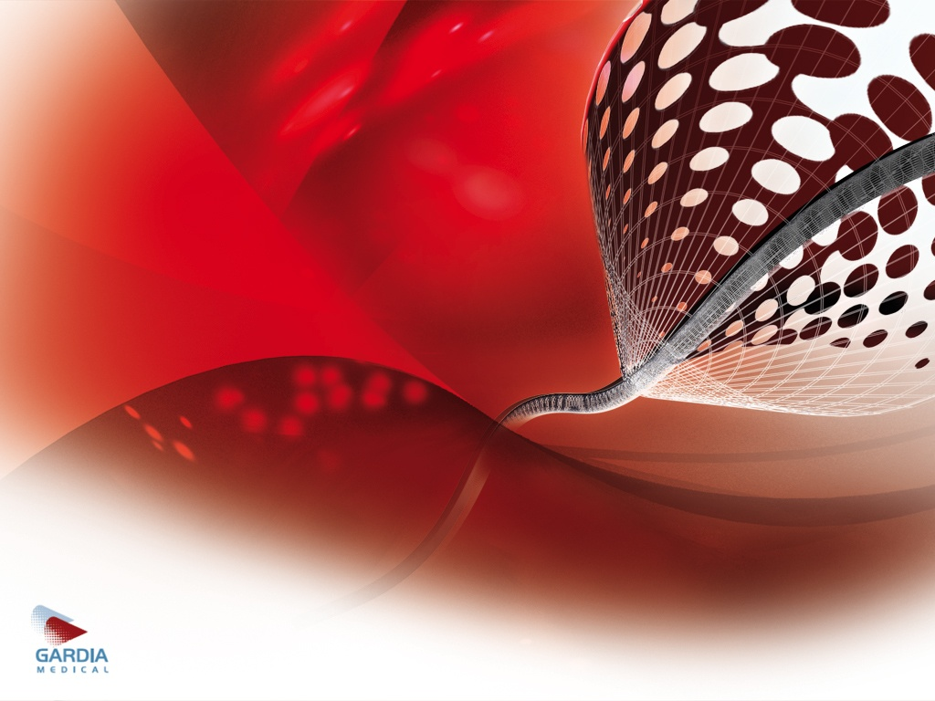

ProCatid MEDICAL®
^{UniGrd (WIRION)}
The Optimal Embolic Protection Device
March 2026

Slide 2

Procatid History Highlights
Details | Highlight | Year
Three founders closed an investment of ≈ 6M$ with Medica (Ehud Geller) | Gardia founded | 2007
Caesarea. Rambam, Haifa | Feasibility, and animal trial completed | 2008
Leipzig Germany. Prof. Scheinert (20 pt.) | FIH completed | 2009
Creganna, Ireland | Manufacturing upscale | 2009
50 more patients in Europe | CE for Carotid | 2010
 | FDA study in US | 2012-14
 | Gardia sold to Allium | 2012-3
 | FDA approval | 2015
Prereferral right only, name changed to Procatid | CSI buy Gardia from ALMD | 2020
ALMD get rest of money | ABBOT buy CSI | 2023

Slide 3
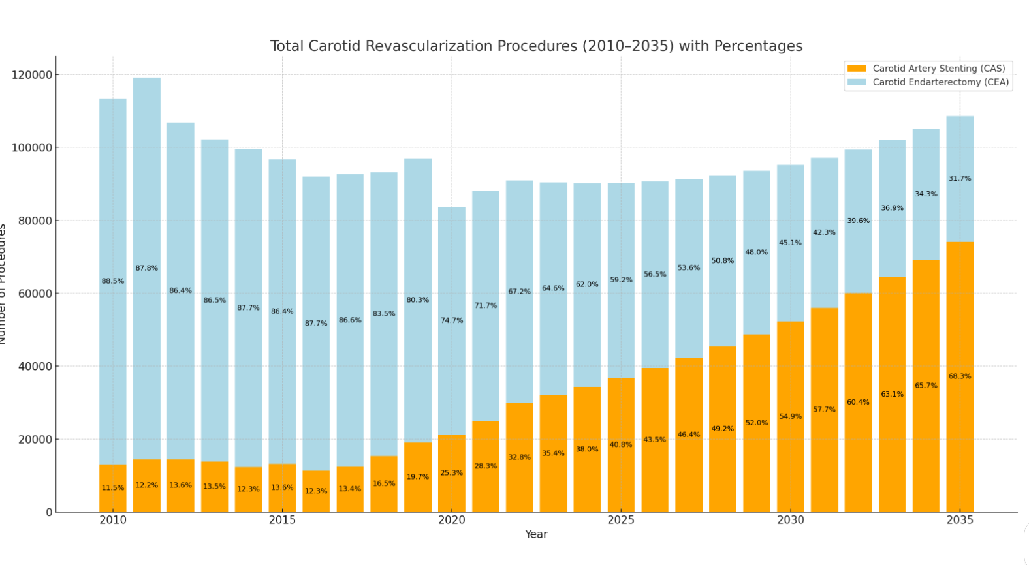
Carotid Artery Stent vs. Carotid Endarterectomy Medical- WIRION EPD
Significant change in practice due to improved stent technology and routine use of Embolic Protection Device (EPD)
Increasing volume of CAS
Stable / decreasing volumes of CEA
US Market Analysis

Slide 4
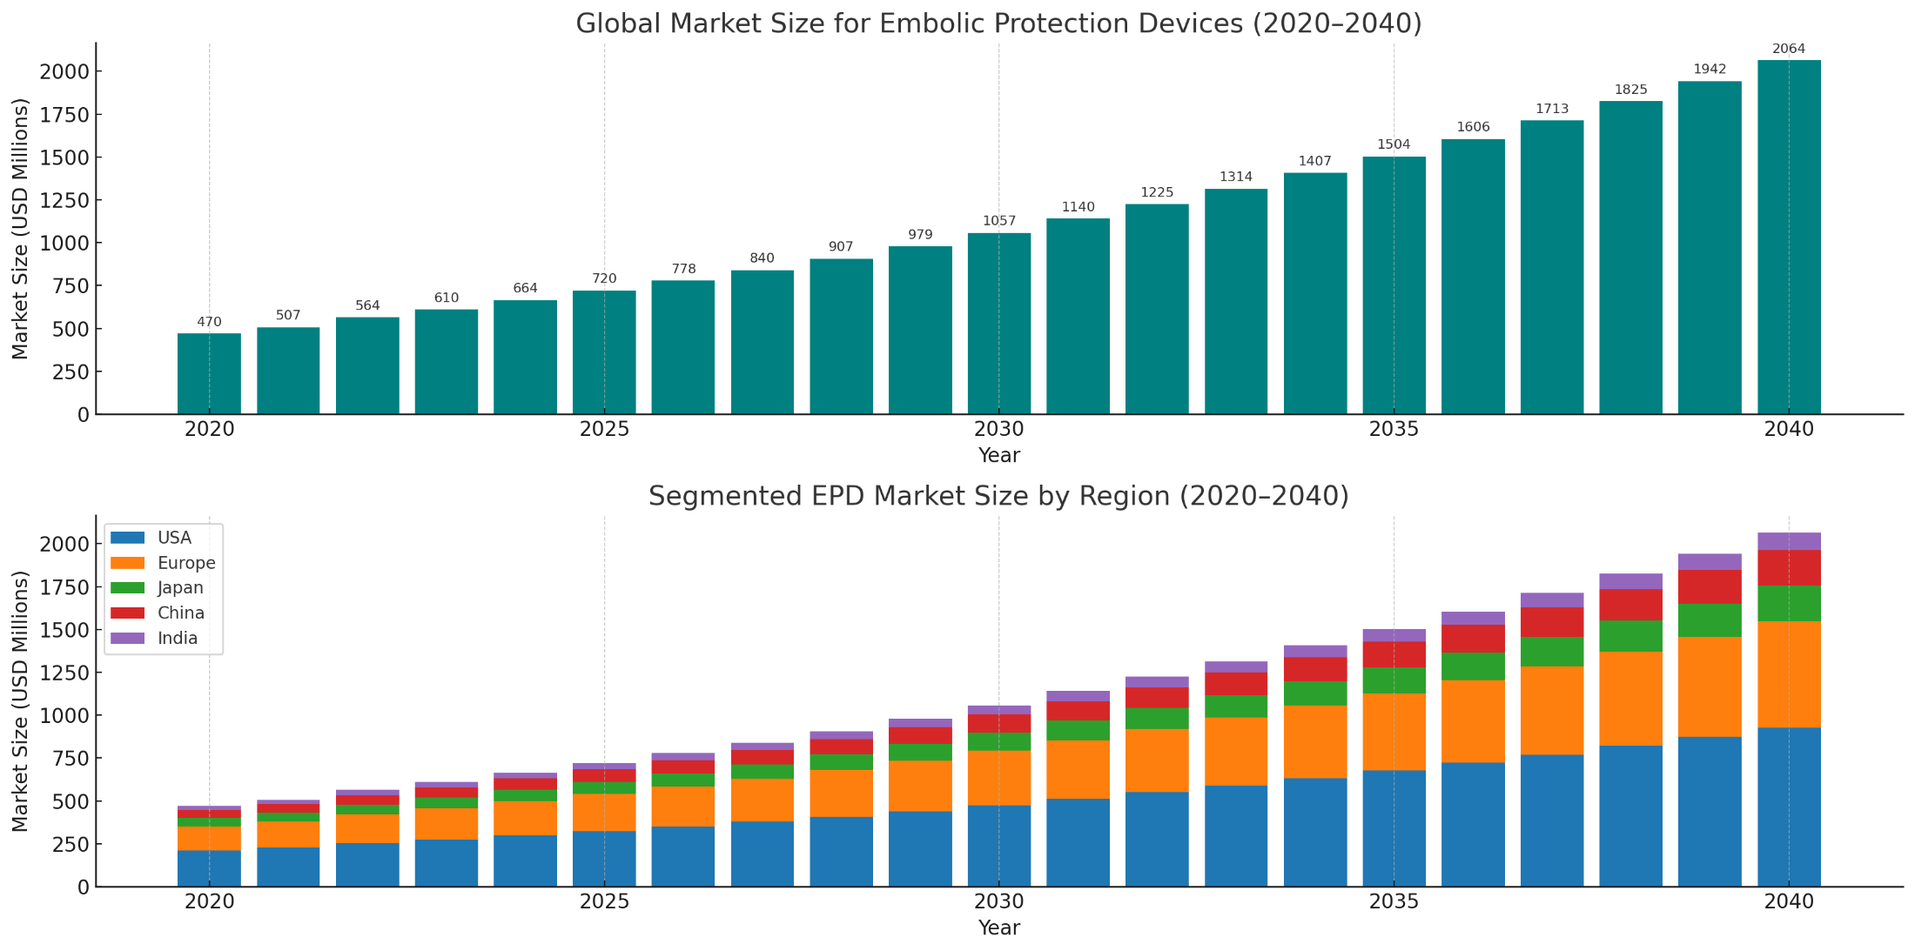
Global and Segmented EPD Market 2020-2040 Endarterectomy Medical- WIRION EPD

Slide 5
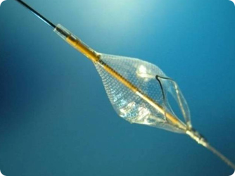
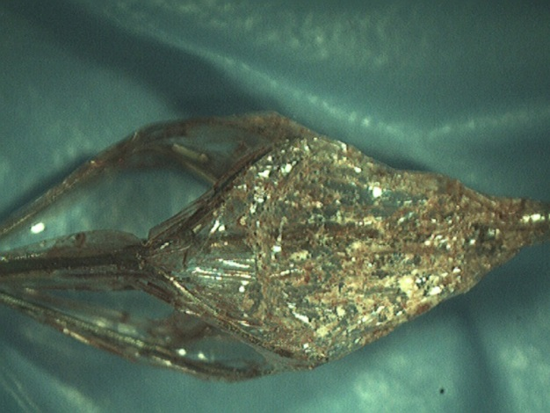
ProCatid Medical- UniGrd (Wirion) (WIRION) EPD
Next Generation Embolic Protection Device
FDA approved for the Lower Extremities (2018)
FDA (2015) and TGA (2016) approved for Carotid
CE and AMAR approved for all interventional vascular procedures including: LE, Carotid, Renal, TAVI, SVG
Publications in the JACC and Circulation Journals
Exceptional safety profile demonstrated in FDA studies
Over 1,300 successful clinical procedures
Scalable production structure with Creganna as main SC
Huge market opportunity
Innovative delivery, locking and retrieval technology

Slide 6
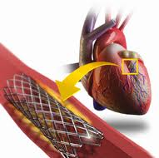
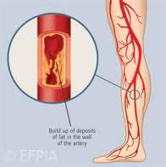
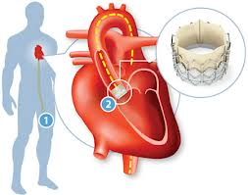
UniGrd (WIRION) Indications
Indications for use
MI, death
Stroke, death
Stroke, death
Kidney failure
Amputations
MI, stroke, death
Coronary Stenting
SVG stenting
Coronary stenting
Peripheral Stenting
Carotid stenting
Renal stenting
Lower limbs stenting
Trans Aortic Valve Implantation (TAVI)
EPD use may reduce
>1,300 cases in a range of indications

Slide 7
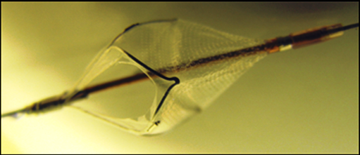
UniGrd (WIRION) EPD
WIRION The Ultimate Solution
d
The only embolic filter that can be used with any guide wire throughout the entire procedure
Allows optimal filter positioning:
anywhere on the guide wire
anywhere along the vessel
Wide vessel size range
Excellent deliverability
High capture efficacy
Great support and stability
Clear visibility
Superior retrieval technology
Excellent feedback from the medical community
Simple and easy to use
Any-wire is a critical feature
Optimal wall apposition
Strong capturing ability

Slide 8
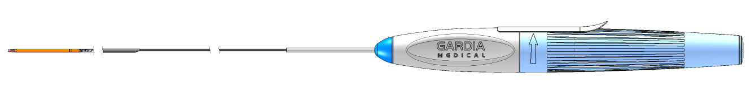

System Components
Delivery Catheter: Rapid exchange, 3.2F - contains and delivers the filter unit
Delivered over any 0.014” guidewire
Proprietary locking mechanism secures the filter to the wire
Filter deploys by withdrawing the delivery catheter
Filter Unit: Nylon mesh and Nitinol frame, Concentric design with 120μ pore size
Compatible with vessels from 3.5-6.0mm
Retrieval Catheter: Rapid exchange, 4.8F with retractable tip
Captures and retrieves the filter unit with any embolic debris
Retractable tip improves deliverability, then allows smooth capture

Slide 9
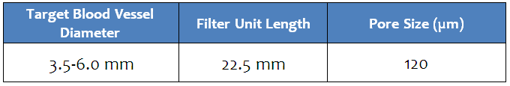
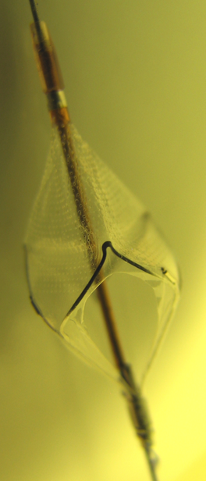
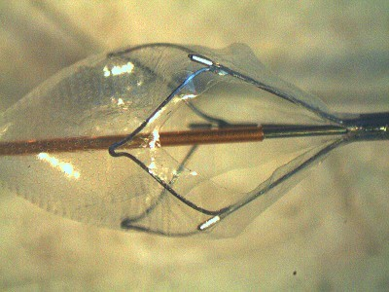
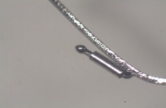
Filter Unit
The filter unit is a Nylon membrane on a Nitinol frame
3 marker bands identify the proximal edge of the filter membrane
Distal and proximal marker bands identify filter landing zone
The locking mechanism is integral to the proximal edge of the Nitinol frame and secures the filter unit to any 0.014” guidewire
Filter can lock anywhere on the guidewire anywhere in the vessel
Radiopaque
Markers on Filter
Proximal and Distal Radiopaque Markers

Slide 10
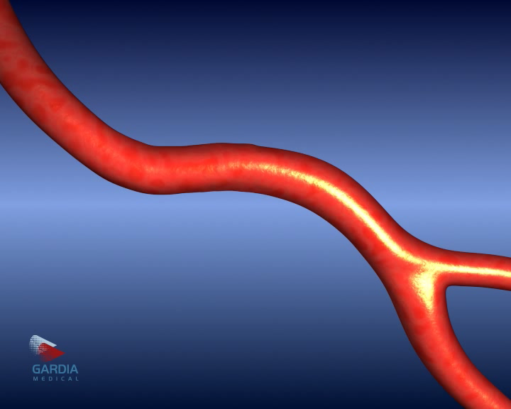
Animation

Slide 11





UniGrd (WIRION) – next generation EPS
Market Share
> 50 %
Potential market leader
3rd Generation:
• Any wire throughout the entire procedure
• Desired location
< 35 %
2nd Generation:
• Wire exchange to a dedicated wire
• Fixed filter location
1st Generation:
• Dedicated wire
• Fixed filter location

Slide 12
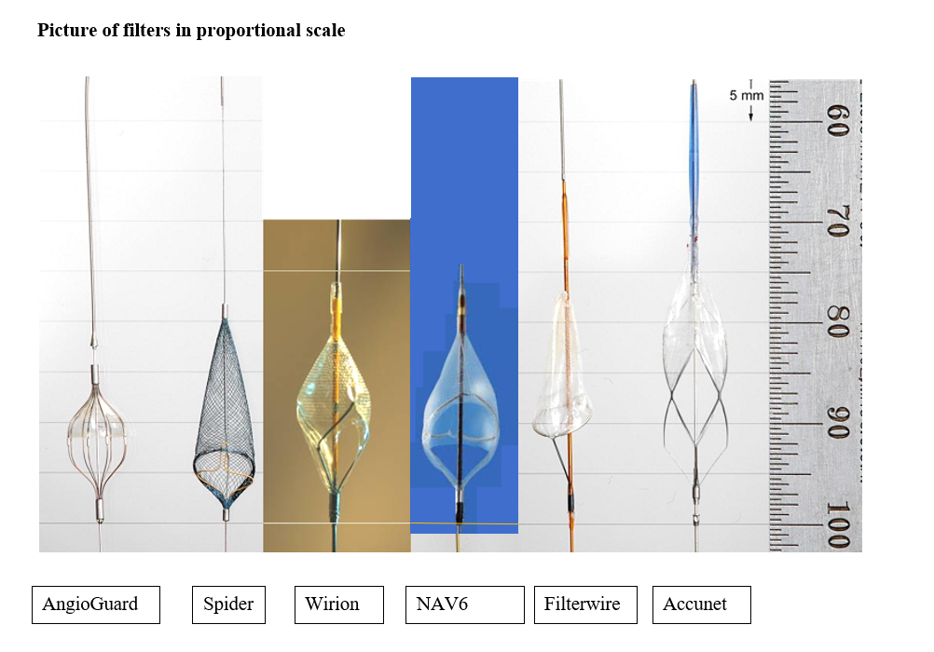
Compare filters

Slide 13
WISE Clinical Study – FDA carotid indication
Objective: Comparing the safety and performance of WIRION™ in patients undergoing CAS to a performance goal based on an analysis of the results of previous US carotid stents with embolic protection studies.
Demography: Similar to that of the historical control population. Similar age and similar prevalence of co-morbidities including hypertension, diabetes mellitus and heart failure. The majority of the patients were asymptomatic in both WISE study (88.3%) and historical control (73%).
Primary endpoint: A composite of Major Adverse Cardiac and Cerebrovascular Events (MACCE) including Death, Stroke, and Myocardial Infarction (DSMI) occurring within 30±7 days post-procedure.
The WIRION system successfully met the primary endpoint. MACCE rate was 3.3% compared to an historic control MACCE rate of 6.3%. 0% death.

Slide 14

WISE LE Clinical study- FDA LE Indication
Objective: Demonstrate the safety and performance of the WIRION™ in subjects undergoing Lower Extremity atherectomy for the treatment of PAD
Indication of USE: Atherectomy independent labeling (unique) for all atherectomy devices (orbital, rotational, directional, laser)
Design- 103 patients, 30 days FU
Primary endpoint: Absence of major adverse events (MAE) to 30 days post procedure
Performance goal study: based on Covidien DEFINITIVE LE & DEFINITIVE Ca++ trials
The WIRION system successfully met the primary endpoint. MAE was 1.9% compared to an historic control MAE rate of 10.6%.

Slide 15
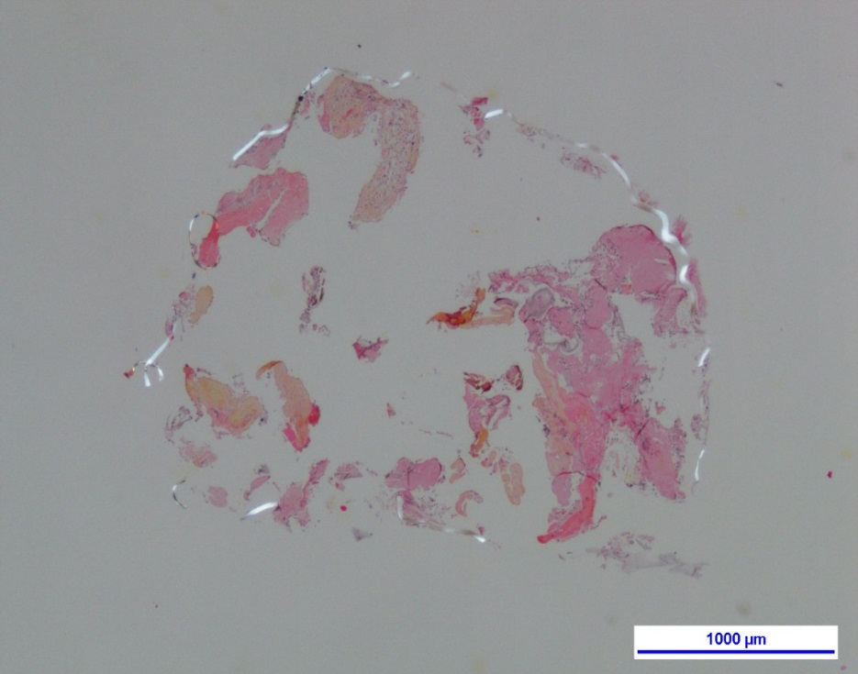
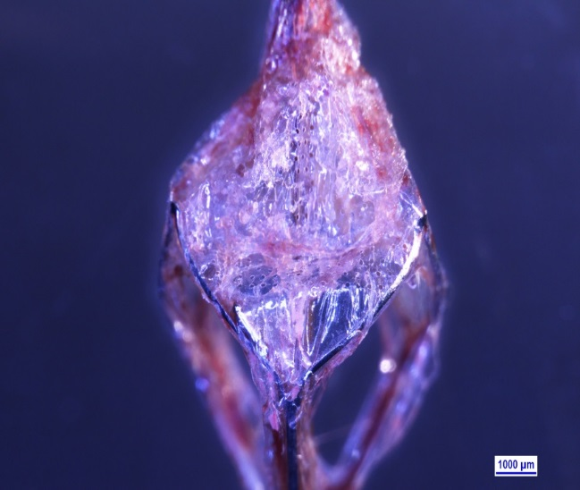

Histology analysis of the filters
Histology analysis – LE data
15
The purpose of the histology analysis was to evaluate the debris captured by the WIRION.
The histopathologic analysis for the filters demonstrated that WIRION successfully captured debris in 100% of filters analyzed. Large thrombi ranged >1mm was found in 31% of the filters.
Segment for histology
Fibrin aggregates
Fibrous tissue
Blood flow direction
Filter nylon mesh
Notes:
15

Slide 16
Summary
Histology analysis – LE data
16
ProCatid has a unique embolic protection system (WIRION) that truly enables “wire of choice” in a variety of indications
UniGrd (WIRION) has FDA Peripheral indication and FDA & TGA clearances for the carotid indication and it is CE marked and AMAR approved for all vascular indications
While historically the market for EPD’s was largest in Carotid Stenting, the use of EPD’s in peripheral vessels has grown rapidly, and is currently the larger market segment with the highest growth rate
Procatid has clinical experience in carotid stenting, lower limb peripheral atherectomy and stenting, renal, SVG as well as TAVI procedures
Physician feedback has been very positive regarding the clinical data, the handling of the device and the simplicity of operation
Notes:
16

Slide 17
ProCatid Medical – competitor analysis
WIRION™ vs. Spider (COV)
UniGrd (WIRION™) vs. Spider, leading protection device by MDT
 | WIRION | Spider
Start with Wire of Choice | Yes | Yes
Exchange to Dedicated Wire | No | Yes
Filter | Nylon Membrane (120μ) | Nitinol Mesh (190μ nominal pore size, up to 400μ proximal)
Filter Frame | Concentric Frame | Eccentric Frame
Delivery Catheter | 3.2F | 3.2F
Landing Zone | 3.5cm | 4-5cm
The Spider EPD by MDT (formerly Covidien) is the only other EPD claiming “wire of choice”. However, the “wire of choice” must be exchanged for the Spider dedicated wire prior to filter deployment, and the rest of the case is performed over that wire.
Despite this, the Spider is the leading EPD. The WIRION improves upon this design by using the wire of choice for the entire case, eliminating an exchange step, allowing filter positioning anywhere on the wire, and potentially improving capture efficiency and retrieval.

